Slide 1
Project WASH
Water and Sanitation Hygiene

Slide 2
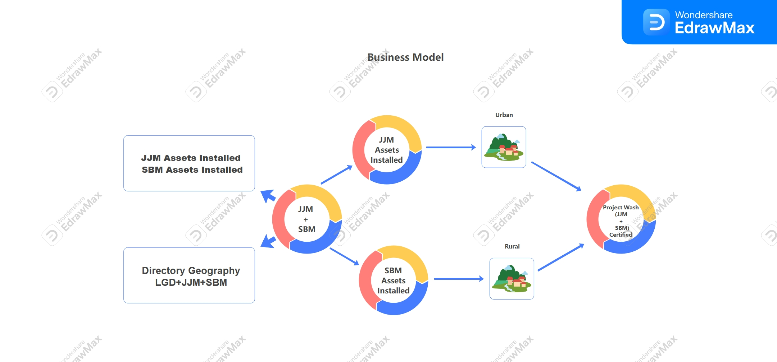
Basic Architecture of Project WASH

Slide 3
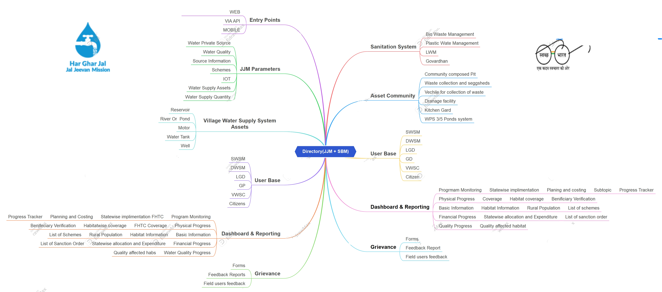
JJM + SBM Modules and Structure

Slide 4
Objective
Project JJM (Jal Jeevan Mission):The major Gov initiative in India aimed to provide safe and sustainable drinking water to all rural households in India.
Project SBM(Swachh Bharat Mission): The major Gov initiative in India aimed to ambitious sanitation and cleanliness campaign launced by Gov of India.
Project WASH: Project WASH focus on creating a common platform for both the programs running by the Gov of India.
Water + Sanitation = WASH

Slide 5
Business Case & Scope of Work
Geographical Boundaries
States
District
Panchayats
Villages
Habitats
Blocks

Slide 6
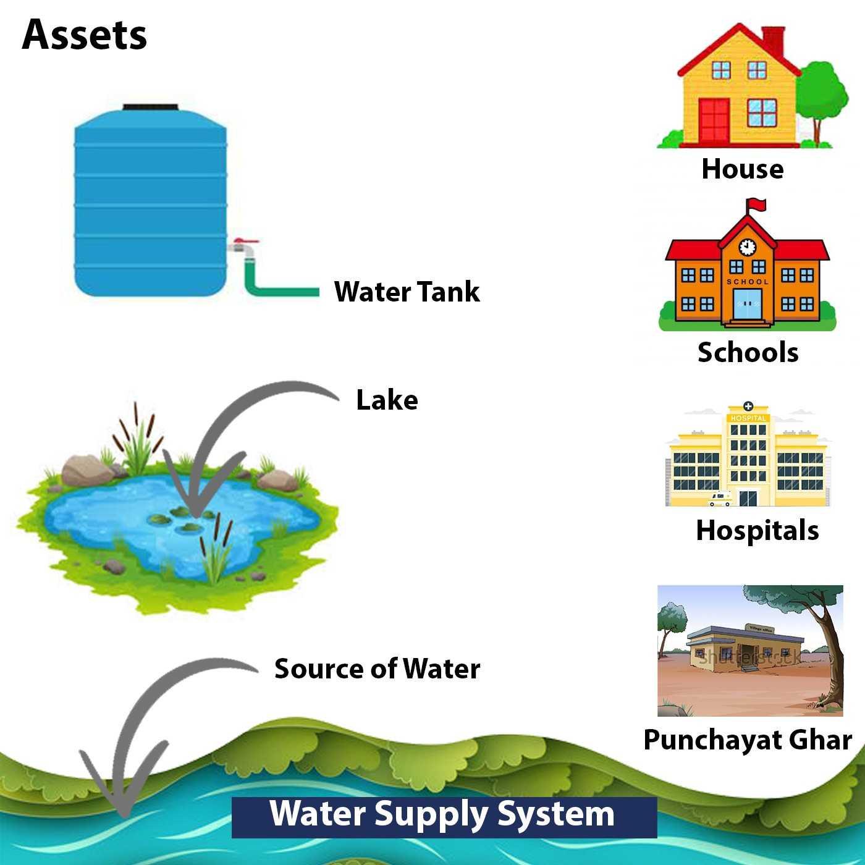
Assets of JJM

Slide 7
Assets of SBM
SOAK
Pits HH Level
Kitchen ward HH Level
Bio Gas Plant
Composed pits HH Level
Measuring Variable= Open defication free(ODF)

Slide 8
Sanitation
Different Schemes falls under it are:
Plastic Waste Management
Bio Waste Management
Govardhan
SLWKA
IHHL

Slide 9
Problem Statement
LGD: Primary objective of the LGD is to facilitate state dept. to update the directory with newly formed panchayats/ Local bodies, re-org in panchayats, conversion from rural to urban etc and provide the same info in public domain.
Key feature of LGD is to generate unique code for each local gov body, each local body is assigned with a unique code. Real time updation of LGD is sometime not possible so if any gov entity wants to run any program for example pulse polio mission so they create layers around it and after that the codes which get generated via that layer get mapped with LGD called as “ CODE MAPPING”.

Slide 10
Problem Statement
LGD
MOPR
Code Mapping
Polio
Code Generation
Layers

Slide 11
KPI’s
Total Number of HH’s
HH’s with tap water connection
Total ODF Plus Villages
Total villages with TAP water connection + ODF
Total Villages not having Tap Water Connection
Total Villages not having ODF
Total Villages not having having both(FHTC + ODF )

